Slide 1
WHISPAR and what it means to me?
(Wigan Healthier partnership Integrated Specialist Palliative care Active Response)
This leaflet explains how our partner organisations across Wigan borough, are working together to provide a responsive service for people at home who have a variety of Palliative and individual care needs.
Which teams work together to provide the service?
Wigan and Leigh Hospice in your Home Team
Marie Curie Team
Wigan and Leigh Hospice Practice Development Team ( hospice in your care home)
District Nurse Community Team
AHP Macmillan Team (Physio, Dietitian, Speech and Language Therapist & Occupational therapist) - employed by Wrightington Wigan and Leigh Hospital
Wigan and Leigh Hospice Nurse Specialist Team
Wigan and Leigh Hospice & Wrightington Wigan and Leigh Hospital Specialist Palliative Care Medical Team
GPs and other community teams will be getting involved as we grow WHISPAR
All Clinical teams across the borough can refer you to the WHISPAR service
Why are WHISPAR team members wearing different uniforms on visits?
Members of the WHISPAR Team work within their individual teams but come together following the initial assessment when their expert knowledge and skills are required to support you and those important to you.
What does the WHISPAR service provide?
Once a WHISPAR referral is made the team review it and decide which team is best placed to meet your needs.
A member of the team will contact you to discuss your care priorities and any worries and concerns you and your family / carers have.
A plan will be put in place to provide the care and support you require.
Staff will also be able to give you information and advice related to additional services available and refer you to other teams as your needs change.

Slide 2
Advantages of WHISPAR
Provides a single point of contact for you and your family.
Responds to changing patient needs seven days per week.
Staff are trained to listen and understand patient and carers worries and concerns and identify priorities within Advanced Care Plans.
Reduce multiple care visits which often causes confusion.
Identify level of support required and identify appropriate level of expertise required to address new care needs and symptom control.
Arrange for a variety of services to support the patient.
Signpost family and carers to additional information and support.
Work with patients and other services to ensure you have the medication and equipment you need.
The WHISPAR team are here to:
Listen and support you and those important to you.
Ensure your needs are met in your preferred place of care.
Work collaboratively with each other.
ENSURE the RIGHT SUPPORT by the RIGHT PEOPLE at the RIGHT TIME
The WHISPAR team put all the pieces together to ensure you and those important to you have the care and support you need

Slide 3
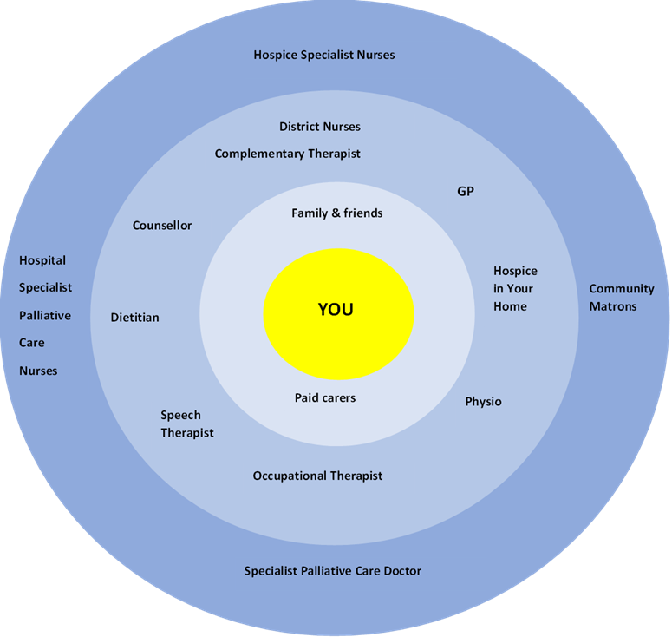
WHISPAR Palliative Care Model
This diagram represents the provision available to look after you when you need palliative care. The circles represent the services available as your needs become more complex. You may not need any services, or you may have one or more services involved. The Hospital Specialist Palliative Care Nurses will support you should you need admission to hospital.
WHISPAR helps to co-ordinate your care to
ENSURE the RIGHT SUPPORT by the RIGHT PEOPLE at the RIGHT TIME

